Slide 1
Unit I - INTRODUCTION TO FORECASTING

Slide 2
THE FORECASTING PROCESS
A process is a series of connected activities that transform one or more inputs into one or more outputs.
All work activities are performed in processes, and forecasting is no exception. The activities in the forecasting process are:
1. Problem definition
2. Data collection
3. Data analysis
4. Model selection and fitting
5. Model validation
6. Forecasting model deployment
7. Monitoring forecasting model performance

Slide 3
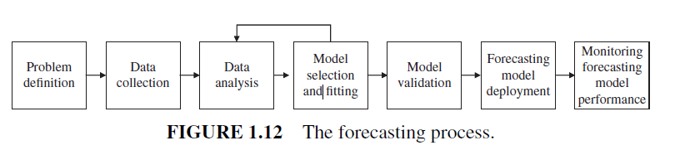

Slide 4
1. Problem definition involves developing understanding of how the forecast will be used along with the expectations of the “customer” (the user of the forecast).
Questions that must be addressed during this phase include the desired form of the forecast (e.g., are monthly forecasts required), the forecast horizon or lead time, how often the forecasts need to be revised (the forecast interval), and what level of forecast accuracy is required in order to make good business decisions.

Slide 5
2. Data collection consists of obtaining the relevant history for the variable(s) that are to be forecast, including historical information on potential predictor variables.
The key here is “relevant”; often information collection and storage methods and systems change over time and not all historical data are useful for the current problem.
Often it is necessary to deal with missing values of some variables, potential outliers, or other data-related problems that have occurred in the past.
During this phase, it is also useful to begin planning how the data collection and storage issues in the future will be handled so that the reliability and integrity of the data will be preserved.

Slide 6
3. Data analysis is an important preliminary step to the selection of the forecasting model to be used.
Time series plots of the data should be constructed and visually inspected for recognizable patterns, such as trends and seasonal or other cyclical components.
The purpose of this preliminary data analysis is to obtain some “feel” for the data, and a sense of how strong the underlying patterns such as trend and seasonality are.
This information will usually suggest the initial types of quantitative forecasting methods and models to explore.

Slide 7
4. Model selection and fitting consists of choosing one or more forecasting models and fitting the model to the data. By fitting, we mean estimating the unknown model parameters, usually by the method of least squares

Slide 8
5.Model validation consists of an evaluation of the forecasting model to determine how it is likely to perform in the intended application.
must examine what magnitude of forecast errors will be experienced when the model is used to forecast “fresh” or new data.
data splitting, where the data are divided into two segments—a fitting segment and a forecasting segment.
The model is fit to only the fitting data segment, and then forecasts from that model are simulated for the observations in the forecasting segment.

Slide 9
6. Forecasting model deployment involves getting the model and the resulting forecasts in use by the customer.
It is important to ensure that the customer understands how to use the model and that generating timely forecasts from the model becomes as routine as possible.

Slide 10
7. Monitoring forecasting model performance should be an ongoing activity after the model has been deployed to ensure that it is still performing satisfactorily.
monitoring of forecast errors is an essential part of good forecasting system design.
Control charts of forecast errors are a simple but effective way to routinely monitor the performance of a forecasting model.

Slide 11
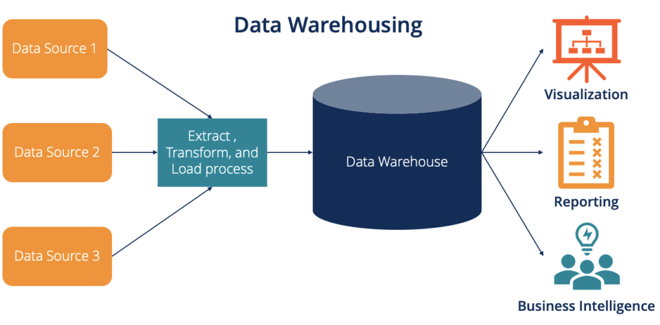
Data for Forecasting- The Data Warehouse
In most modern organizations data regarding sales, transactions, company financial and business performance, supplier performance, and customer activity and relations are stored in a repository known as a data warehouse.

Slide 12
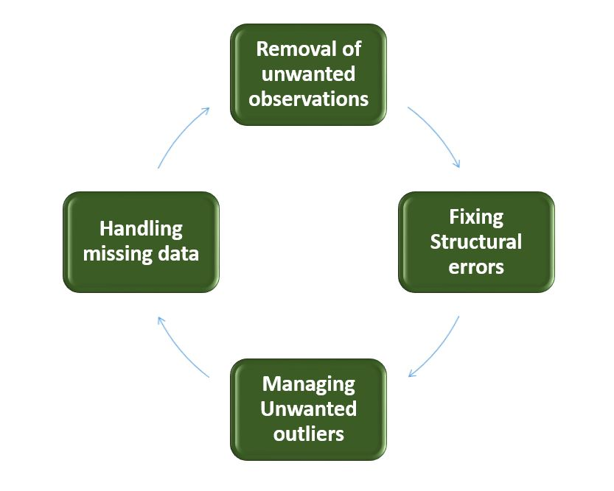
Data Cleaning
Data cleaning is the process of examining data to detect potential errors, missing data, outliers or unusual values, or other inconsistencies and then correcting the errors or problems that are found.
Effective data cleaning can greatly improve the forecasting process.
Notes:
Sometimes errors are the result of recording or transmission problems, and can be corrected by working with the original data source to correct the problem.

Slide 13
Data cleaning subjective to ask:
1. Is there missing data?
2. Does the data fall within an expected range?
3. Are there potential outliers or other unusual values?

Slide 14
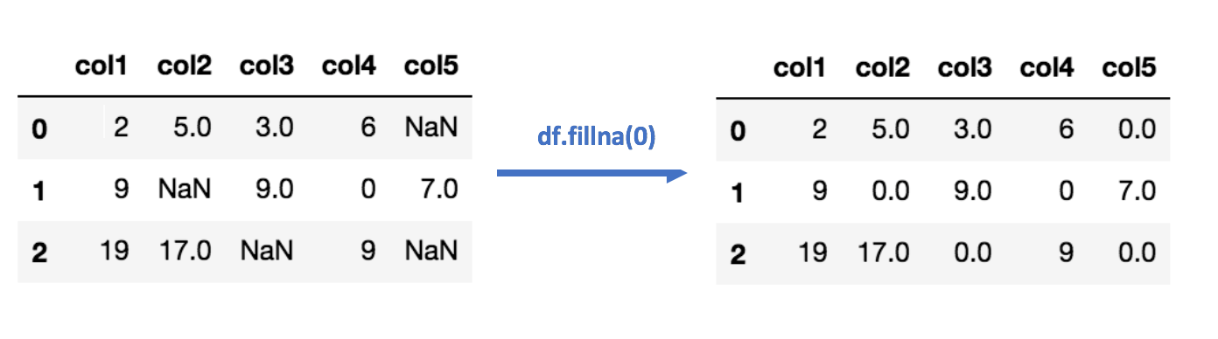
Imputation
Data imputation is the process of correcting missing data or replacing outliers with an estimation process.
Imputation replaces missing or erroneous values with a “likely” value based on other available information.

Slide 15
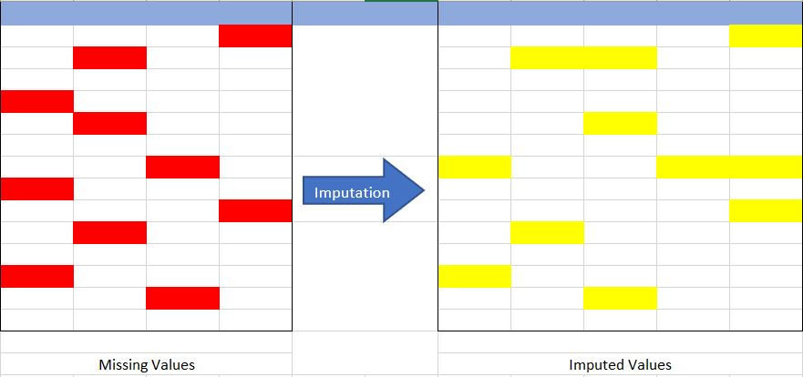

Slide 16
Why Imputation is Important?
Incompatible with most of the Python libraries used in Machine Learning:- Yes, you read it right. While using the libraries for ML(the most common is skLearn), they don’t have a provision to automatically handle these missing data and can lead to errors.
Distortion in Dataset:- A huge amount of missing data can cause distortions in the variable distribution i.e it can increase or decrease the value of a particular category in the dataset.
Affects the Final Model:- the missing data can cause a bias in the dataset and can lead to a faulty analysis by the model.

Slide 17
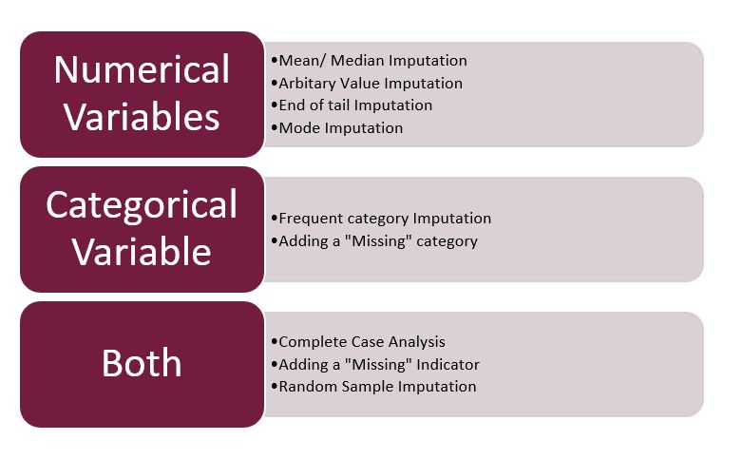
Imputation Techniques of Different Types of Variables
Notes:
https://www.kaggle.com/code/azminetoushikwasi/all-imputation-techniques-with-pros-and-cons

Slide 18
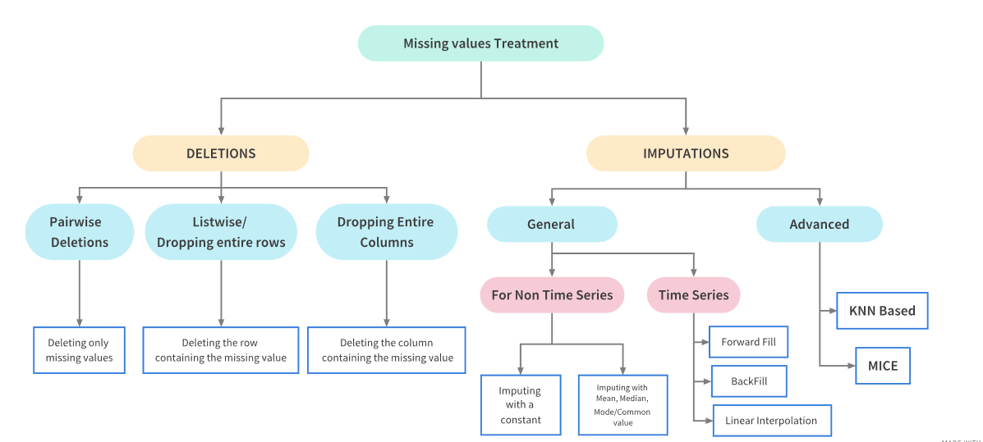

Slide 19
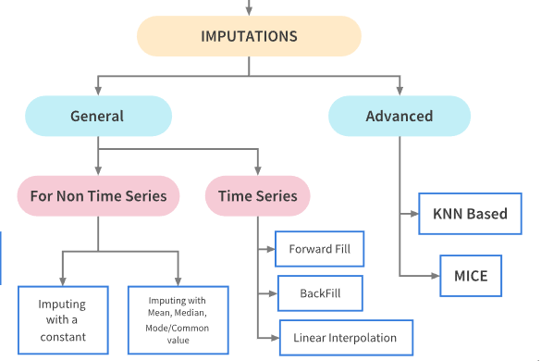
Basic Imputation Techniques
'ffill' or 'pad' - Replace NaN s with last observed value
'bfill' or 'backfill' - Replace NaN s with next observed value
Linear interpolation method

Slide 20
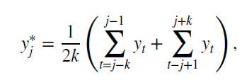
Mean value imputation consists of replacing a missing value with the sample average calculated from the non missing observations.
A variation of mean value imputation is to use a subset of the available historical data that reflects any trend or seasonal patterns in the data.
For example, consider the time series y1, y2,…, yT and suppose that one observation yj is missing.
We can impute the missing value as
where k would be based on the seasonal variability in the data

Slide 21
Regression Imputation
Regression imputation predicts missing values using a regression model based on other variables in the dataset. It establishes a relationship between the variable with missing values and other relevant variables.
Suitable when there's a discernible correlation between the variable with missing values and other variables in the dataset. It leverages the information from correlated features to make informed imputations.
Example:
Consider a dataset with housing prices and features like square footage and number of bedrooms. If the price is missing for some houses, regression imputation involves building a regression model using square footage and number of bedrooms as predictors to predict the missing prices based on the available data.
Remember, if we fill missing values with wrong data, we are adding bias So, carefully consider the nature of your data, reasons for missingness, and the impact on your analysis. Experiment with multiple methods to find the one that best suits for your project.
Notes:
https://www.kaggle.com/discussions/general/469217

Slide 22
Missing Data Imputation using Regression
Regression imputation is a variation of mean value imputation where the imputed value is computed from a model used to predict the missing value.
The prediction model does not have to be a linear regression model. For example, it could be a time series model.
The function random_imputation replaces the missing values with some random observed values of the variable.
The method is repeated for all the variables containing missing values, after which they serve as parameters in the regression model to estimate other variable values.
Simple Random Imputation is one of the crude methods since it ignores all the other available data and thus it's very rarely used. But it serves as a good starting point for regression imputation.
Notes:
https://www.kaggle.com/code/shashankasubrahmanya/missing-data-imputation-using-regression

Slide 23
Hot deck imputation is an old technique that is also known as the last value carried forward method.
Cold deck imputation uses information from a deck of cards not currently in use.

Slide 24
Strategies for Handling Missing Data
1. Mean/Median/Mode Imputation
This method involves replacing missing values with the mean, median, or mode of the respective column.
Ideal for scenarios where missing data is randomly distributed and the overall distribution of the data is roughly normal. It provides a quick and straightforward solution without significantly affecting the original data distribution.
Example:
Consider a dataset with the ages of a group of people. If a few ages are missing, you can fill those missing values with the mean, median, or mode age of the group. For instance, if the ages are [25, 30, 22, NaN, 28], filling the missing value with the mean (26.5), median (25), or mode (28) would be a mean imputation.

Slide 25
2. Forward Fill or Backward Fill (for Time Series Data)
This technique is suitable for time-ordered data. It propagates the last known value forward (forward fill) or the next known value backward (backward fill) to fill missing values.
It's effective when dealing with sequential data, assuming that values tend to remain constant for a certain period. This method is especially relevant in time series analysis where the order of observations matters.
Example:
Imagine you have daily stock prices, and some days have missing values. Using forward fill, you'd take the last known stock price and use it for the missing values on subsequent days. Similarly, backward fill would use the next known stock price for the missing values on previous days.

Slide 26
3. Interpolation
Interpolation involves estimating missing values based on the relationship between known data points. Linear interpolation assumes a linear relationship between consecutive data points.
It is appropriate when there's a logical order or relationship between data points. It provides a more nuanced approach compared to mean/median/mode imputation, capturing trends in the data.
Example:
Suppose you have a dataset with temperature readings at different hours of the day. If the temperature at 12 PM is missing, you can estimate it by interpolating between the temperatures at 11 AM and 1 PM, assuming a linear relationship.

Slide 27
Handle Missing Values in Time Series in Python
# import the data
df= pd.read_csv('/Time-Series.csv', header=None)
# name the columns
df.columns=['Date','Customers’]
# represent date column in date fromat in the order, Year, month and the day
df['Date']=pd.to_datetime(df['Date'], format='%Y-%m’)
# set the Date column be the index of our dataset
df= df.set_index('Date’)
# now check the data shape
df.shape
print(df.head())
Step 1: Importing the Libraries
import pandas as pd
import numpy as np
import matplotlib.pyplot as plt
import seaborn as sns
Step 2: Importing the Dataset
Notes:
https://www.geeksforgeeks.org/how-to-deal-with-missing-values-in-a-timeseries-in-python/

Slide 28
Identifying missing values:
nul_data = pd.isnull(df['Customers']): This line uses the pd.isnull function from pandas to create a new Boolean Series (nul_data) containing True for every missing value in the “Customers” column of the DataFrame df and False otherwise.
Filtering and printing data:
df[nul_data]: This line uses Boolean indexing to filter the original DataFrame df based on the nul_data Series. It essentially selects only the rows where the “Customers” value is missing (i.e., True in the corresponding nul_data series).
nul_data = pd.isnull(df['Customers'])
# print only the data, Customers = NaN
df[nul_data]

Slide 29
Plot the Graph
plt.rcParams['figure.figsize']=(15,7)
# plots our series
plt.plot(df, color='green')
plt.title('Customers visted shop since 1950')
plt.show()

Slide 30
Step 3: Imputing the Missing Values
Here is the explanation of the techniques mentioned for handling missing values in time series data:
Mean Imputation: Replaces missing values with the average of the entire column. Simple and fast, but may not capture trends or local variations.
Median Imputation: Replaces missing values with the median of the entire column. Less sensitive to outliers than mean, but still lacks local context.
Last Observation Carried Forward (LOCF): Replaces missing values with the last known value. Works well for data with rising or constant trends, but can distort trends if they change direction.
Next Observation Carried Backward (NOCB): Replaces missing values with the next known value. Similar to LOCF but for downward trends. Both LOCF and NOCB can introduce artificial jumps or dips.
Linear Interpolation: Estimates missing values by drawing a straight line between the two nearest known data points. Good for capturing linear trends, but less accurate for complex patterns.
Spline Interpolation: Estimates missing values by fitting a flexible, curved line through the data points. More accurate for capturing complex trends and subtle changes than linear interpolation, but computationally more expensive.

Slide 31
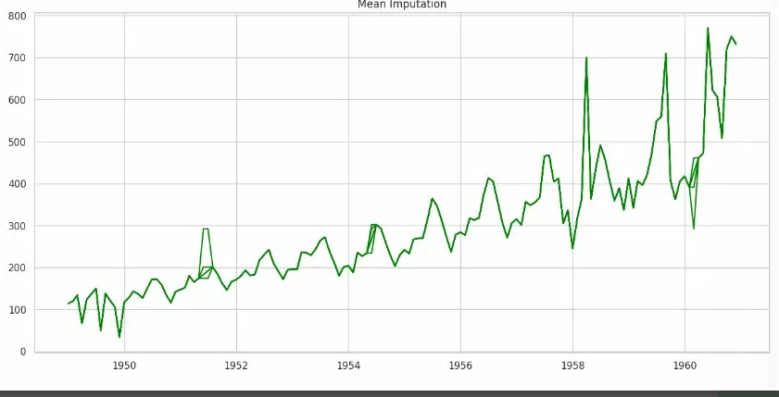
1. Mean imputation
It performs mean imputation on the “Customers” column of the DataFrame. It creates a new column named “FillMean” containing the original values where available and the average value of the “Customers” column where missing.
Python Code
plt.rcParams['figure.figsize']=(15,7)
# fill the missing data using the mean of the present observations
df = df.assign(FillMean=df.Customers.fillna(df.Customers.mean()))
# pass the data and declared the colour of your curve, i.e., blue
plt.plot(df, color='green')
plt.title('Mean Imputation')
plt.show()

Slide 32
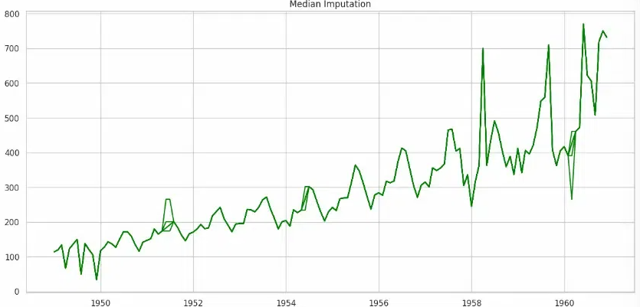
2. Median imputation
It performs median imputation on the dataset. It copies all existing columns and adds a new column named FillMedian. This new column fills in missing values in the Customers column using the median value of that column (df.Customers.median()).
Python code
plt.rcParams['figure.figsize']=(15,7)
# fill the missing data using the of the present observations
dataset = df.assign(FillMean=df.Customers.fillna(df.Customers.median()))
# pass the data and declared the colouyr opf our curve as blue
plt.plot(dataset, color='green')
plt.title('Median Imputation')
plt.show()

Slide 33
Resources for Forecasting
There are three professional journals devoted to forecasting:
Journal of Forecasting
International Journal of Forecasting
Journal of Business Forecasting Methods and Systems

Slide 34
In addition to these specialized forecasting journals, there are several other mainstream statistics and operations research/management science journals that publish papers on forecasting, including:
Journal of Business and Economic Statistics
Management Science
Naval Research Logistics
Operations Research
International Journal of Production Research
Journal of Applied Statistics

Slide 35
Notes:
https://www.kaggle.com/code/shashankasubrahmanya/missing-data-imputation-using-regression
https://www.kaggle.com/code/parulpandey/a-guide-to-handling-missing-values-in-python

Slide 36
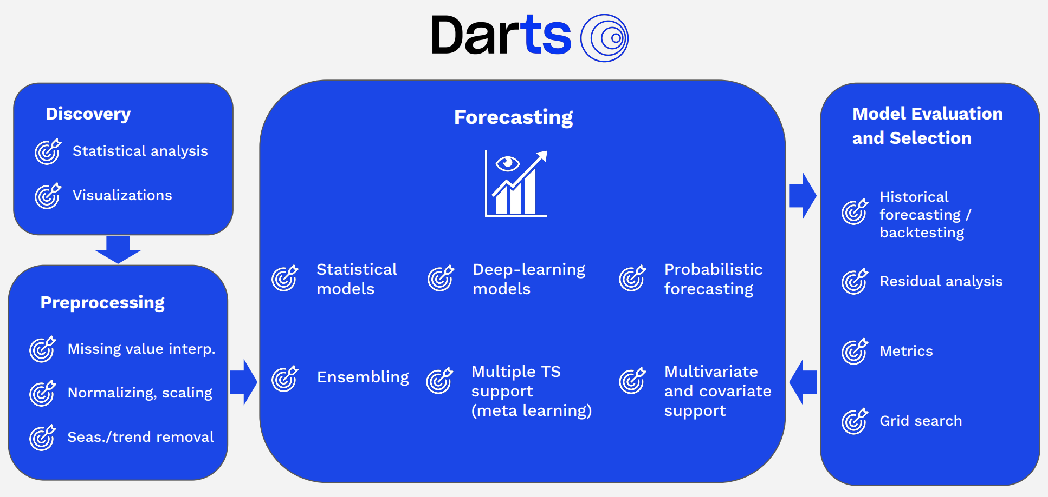
Darts: Time Series Made Easy in Python
https://unit8co.github.io/darts/
Notes:
https://unit8.com/resources/darts-time-series-made-easy-in-python/
https://unit8co.github.io/darts/generated_api/darts.timeseries.html
https://www.kaggle.com/code/prashant111/complete-guide-on-time-series-analysis-in-python#Table-of-Contents
https://www.kaggle.com/code/ankumagawa/time-series-forecast-a-comprehensive-guide

Slide 37
Time Series Preprocessing Techniques | Python implementations | R Implementations
Stationarity | Read here | Read here
Differencing | Read here | Read here
Detrending | Read here | Read here
Deseasonalizing | Read here | Read here
Moving Average | Read here | Read here
Exponential Moving Average | Read here | Read here
Missing Value Imputation | Read here | Read here
Outlier Detection and Removal | Read here | Read here
Time Alignment | Read here | Read here
Data Transformation | Read here | Read here
Scaling | Read here | Read here
Normalization | Read here | Read here
Notes:
https://www.geeksforgeeks.org/time-series-analysis-and-forecasting/#components-of-time-series-data

Slide 38
Time Series Analysis Techniques | Python implementations | R implementations
Autocorrelation Analysis | Read here | Read here
Partial Autocorrelation Functions (PACF) | Read here | Read here
Trend Analysis | Read here | Read here
Seasonality Analysis | Read here | Read here
Decomposition | Read here | Read here
Spectrum Analysis | Read here | Read here
Seasonal and Trend decomposition using Loess (STL) | Read here | Read here
Rolling correlation | Read here | Read here
Cross-correlation Analysis | Read here | Read here
Box-Jenkins Method | Read here | Read here
Granger Causality Analysis | Read here | Read here
Notes:
https://www.geeksforgeeks.org/time-series-analysis-and-forecasting/#components-of-time-series-data

Slide 39
Time Series Forecasting Algorithms | Python implementations | R implementations
Autoregressive (AR) Model | Read here | Read here
ARIMA | Read here | Read here
ARIMAX | Read here | Read here
SARIMA | Read here | Read here
SARIMAX | Read here | Read here
Vector Autoregression (VAR) | Read here | Read here
Theta Method | Read here | Read here
Exponential Smoothing Methods | Read here | Read here
Gaussian Processes Regression | Read here | Read here
Generalized Additive Models (GAM) | Read here | Read here
Random Forests | Read here | Read here
Gradient Boosting Machines (GBM) | Read here | Read here
State Space Models | Read here | Read here
Hidden Markov Model (HMM) | Read here | Read here
Dynamic Linear Models (DLMs) | Read here | Read here
Recurrent Neural Networks (RNNs) | Read here | Read here
Long Short-Term Memory (LSTM) | Read here | Read here
Gated Recurrent Unit (GRU) | Read here | Read here
Notes:
https://www.geeksforgeeks.org/time-series-analysis-and-forecasting/#components-of-time-series-data

